Slide 1
Week-2
https://sites.google.com/site/drmohammadshahidulislam
Instructor: D.MSI

Slide 2
LAN, MAN & WAN
Applications of Networks
Network Topology BSRM
Network Components PINCONA
:protocols, layers and interfaces
Peers, Entities and Peer Entities
Protocol Stacks
Layers at An Interface
Connections Multiplexing
HDLC frame, different control (ISU)
SEQ, NEXT, P/F,DISconect, SABM, FRMR

Slide 3
The Data Link Layer in the Internet
Internet consists of individual machines (hosts and routers) and the communication infrastructure that connects them.
Some of the machines are interconnected using LANs and some are interconnected using point to point lines (especially the ones that are far apart).

Slide 4
Point –to-point lines in the Internet
Normally used in 2 situations: (p: 238)
One LAN communicating with another (acts like a leased line/ dedicated line)
Home user using dial-up connection to connect with internet (also same as leased line)
Fig shown in the next slide
Both the communication uses point-to-point data link protocol(In internet it is called PPP)

Slide 5
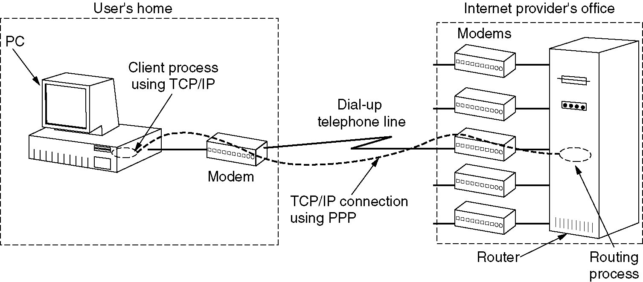
The Data Link Layer in the Internet
A home personal computer acting as an internet host.

Slide 6
PPP - Point to Point Protocol (1)
Provides three features
A framing method; the frame format also handles error detection
A link control protocol called LCP (Link Control Protocol)
A way to negotiate network specific options in a way that is independent of the network layer protocol to be used. The method chosen is to have a different NCP (Network Control Protocol) for each network layer supported
Notes:
PPP handles error detection, supports multiple protocols, allows IP addresses to be negotiated at connection time, permits authentication (using two methods – PAP and CHAP)
PPP format was chosen to closely resemble HDLC frame format. The major difference is that PPP is character oriented, while HDLC is bit oriented protocol. In particular, PPP is using byte stuffing on dialup modem lines, so all frames are integral number of bytes.

Slide 7
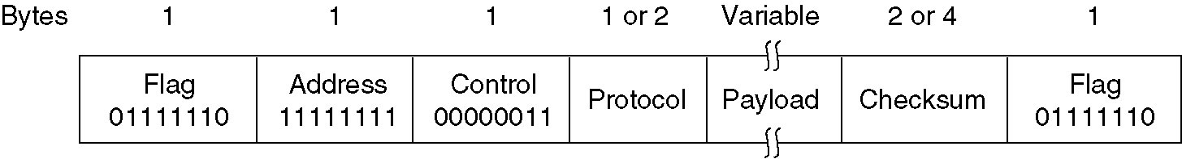
PPP – Point to Point Protocol (2)
All PPP frames start with standard HDLC flag 01111110, which is byte stuffed if occurs in the rest of the frame.
The Address field is always set to 11111111 to indicate that all stations are to accept the frame. Using this value solves the issue of assigning data link layer addresses.
The Control field default value is 00000011 , which indicates an unnumbered frame (doesn’t provide by default reliable transmission using sequence numbers and acknowledgements).
The Protocol field specifies what kind of packet is in the payload field. Codes are defined for LCP, NCP, IP, IPX, AppleTalk and other protocols. Protocols starting with zero are network layer protocols (IP, IPX, etc). Those starting with 1 are used to negotiate other protocols. These include LCP and a different NCP for each network layer protocol supported.
Payload – variable length data, up to some negotiated maximum. If no negotiated maximum value, a default 1500 value is used.
Checksum field is default 2 bytes, but it can be negotiated to 4 bytes.
The PPP full frame format for unnumbered mode operation.
Notes:
All PPP frames start with standard HDLC flag 01111110, which is byte stuffed if occurs in the rest of the frame.
The Address field is always set to 11111111 to indicate that all stations are to accept the frame. Using this value solves the issue of assigning data link layer addresses.
The control field default value is 00000011 , which indicates an unnumbered frame (doesn’t provide by default reliable transmission using sequence numbers and acknowledgements).
Since the address field and control field are constant, LCP can negotiate and option that allows them to be omitted and to save two bytes per frame.
The Protocol field specifies what kind of packet is in the payload field. Codes are defined for LCP, NCP, IP, IPX, AppleTalk and other protocols. Protocols starting with zero are network layer protocols (IP, IPX, etc). Those starting with 1 are used to negotiate other protocols. These include LCP and a different NCP for each network layer protocol supported. The default size of the Protocol field is 2 bytes, but it can be negotiated down to one byte by LCP.
Payload – variable length data, up to some negotiated maximum. If no negotiated maximum value, a default 1500 value is used.
Checksum field is default 2 bytes, but it can be negotiated to 4 bytes.

Slide 8
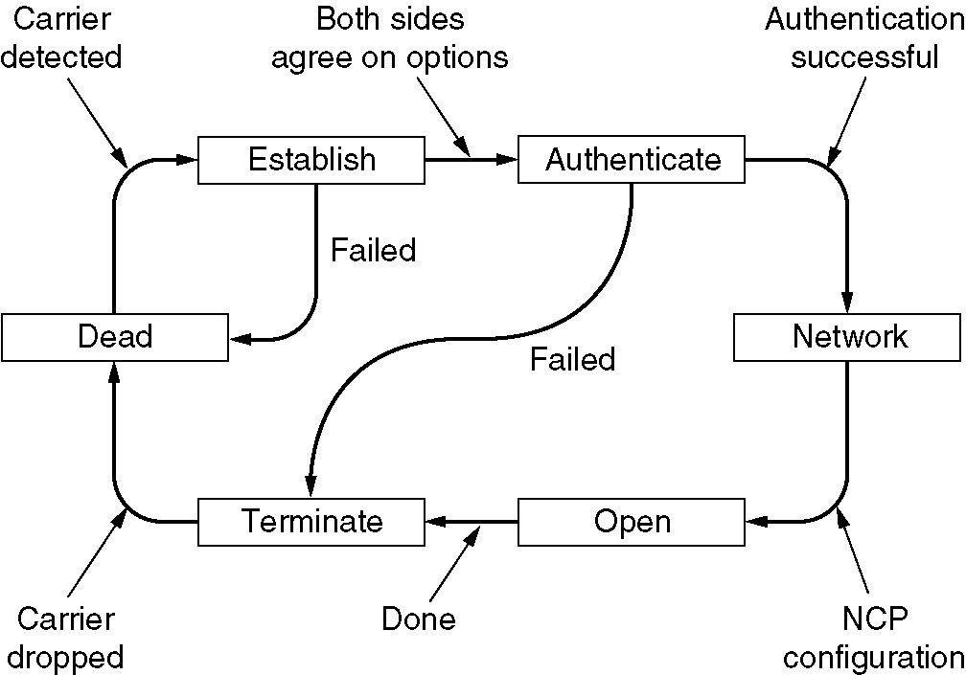
PPP – Point to Point Protocol (3)
A simplified phase diagram for bring a line up and down.
Notes:
Line is in DEAD state. After physical connection is established, the line moves into ESTABLISHED phase. At that point, LCP option negotiation begins, and if successful leads to AUTHENTICATE. If authentication successful, the NETWORK state is entered. During this state, the appropriate NCP protocol is invoked, to configure the network layer. If the configuration is successful, the OPEN state is entered, where data transfer can take place. When the data transport is finished, the line moves into TERMINATE phase, and from there back to DEAD when the carrier is dropped.

Slide 9
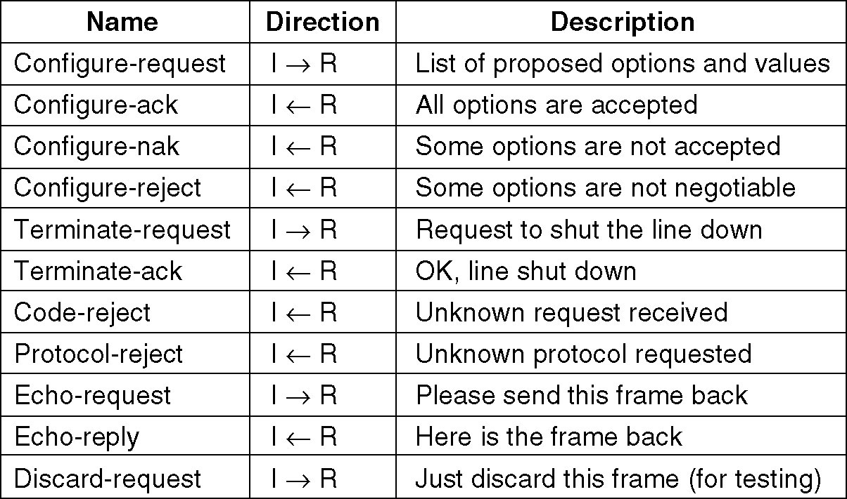
PPP – Point to Point Protocol (4)
The LCP frame types.

Slide 10
DLL in ATM
http://en.wikipedia.org/wiki/Asynchronous_Transfer_Mode
In the ISO-OSI reference model data link layer (layer 2), the basic transfer units, datagrams, are generically called frames.
In ATM these frames are of a fixed (53 octets or bytes) length and specifically called "cells".

Slide 11
The structure of an ATM cell
An ATM cell consists of a 5-byte header and a 48-byte payload.
The choice of 48 bytes was political rather than technical
ATM defines two different cell formats: UNI
(User-Network Interface) and NNI (Network-Network Interface).
Most ATM links use UNI cell format.

Slide 12
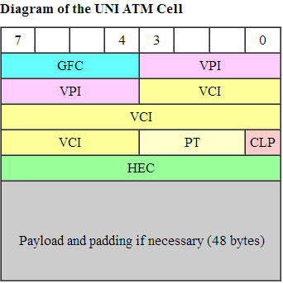
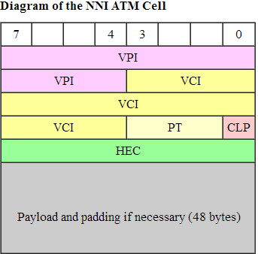
GFC = Generic Flow Control (4 bits) (default: 4-zero bits)
VPI = Virtual Path Identifier (8 bits UNI) or (12 bits NNI)
VCI = Virtual Channel identifier (16 bits)
PT = Payload Type (3 bits)
CLP = Cell Loss Priority (1-bit)
HEC = Header Error Control

Slide 13
GFC : A UNI cell reserves the GFC field for a local flow control/submultiplexing system between users.
VCI & VPI: The VCI, together with the VPI, is used to identify the next destination of a cell as it passes through a series of ATM switches on its way to its destination.
PT: ATM uses the PT field to designate various special kinds of cells for operations, administration and management (OAM) purposes

Slide 14
CLP : the network can either drop the cells or mark the Cell Loss Priority (CLP) bit (to identify a cell as potentially redundant) upon some checksum.
HEC : ATM link protocols use the HEC field to drive a CRC-based framing algorithm, which allows locating the ATM cells with no overhead

Slide 15
Lan Procol: Standards IEEE 802
Why Standardization?
every carrier devised its own system. This lack of standards meant that hardware and software could not be mass produced, which kept prices high and acceptance low.
For an example:
Many people in the industry realized that having a broadband wireless standard was the key element missing, so IEEE was asked to forma committee composed of people from key companies and academia to draw up the standard. The next number available in the 802 numbering space was 802.16, so the standard got this number. Work was started in July 1999

Slide 16
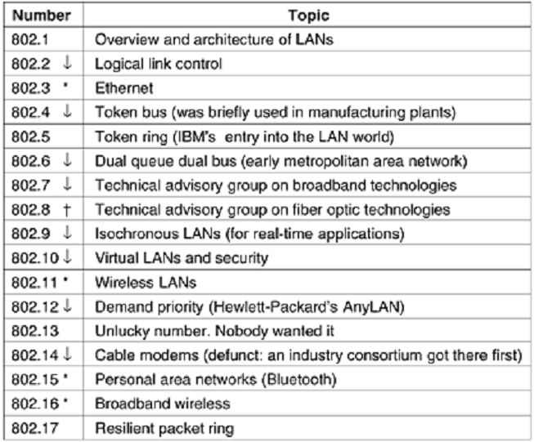
The 802 working groups. The important ones are marked with*. The ones marked with ↓ are hibernating. The one marked with † gaveup and disbanded itself.

Slide 17
IEEE 802 Subgroups and their Responsibilities
802.1
Internetworking
802.2
Logical Link Control (LLC)
802.3
Ethernet
802.4
Token Bus LAN
Continued

Slide 18
IEEE 802 Subgroups and their Responsibilities (Cont.)
802.5
Token Ring LAN
802.6
Metropolitan Area Network
802.7
Broadband Technical Advisory Group
802.8
Fiber-Optic Technical Advisory Group
Continued

Slide 19
IEEE 802 Subgroups and their Responsibilities (Cont.)
802.9
Integrated Voice/Data Networks
802.10
Network Security
802.11
Wireless Networks
802.12
Demand Priority Access LANs
Ex: 100BaseVG-AnyLAN

Slide 20
Wireless LAN Protocols
802.11
1-2 Mbps, 2.4 GHz, FHSS and DSSS
IEEE 802.11a
54 Mbps, 5 GHz, Orthogonal Frequency Division Multiplexing
IEEE 802.11b
11 Mbps, 2.4 GHz, DSSS
IEEE 802.11g
20+ Mbps, 2.4 GHZ
108 Mbps, 2.4 GHz (Extreme G)
IEEE 802.11n

Slide 21
LAN Lower Layer Protocol:
IEEE 802.3 Carrier Sense Multiple Access/ Collision Detection (CSMA/CD)

Slide 22
An Overview of CSMA/CD
CSMA/CD has two components as mentioned
First is the Carrier Sense Multiple Access (CSMA) component
Second is the Collision Detection (CD) component

Slide 23
CSMA Component of CSMA/CD
CSMA (Carrier Sense Multiple Access)
Check the bus for traffic
If the bus is free, then transmit
If it is busy, wait for a random period of time before attempting to transmit again

Slide 24
CD Component of CSMA/CD
Two stations may check the data bus simultaneously
Both may find the line free and engage in the transmission of data
Both transmission will collide
CD component will detect this collision
Inform the workstations of the collision
Each station will wait for a random period of time before attempting to transmit again

Slide 25
CSMA/CD Usage
Used extensively in bus LANs

Slide 26
CSMA/CD Standards
Highly standardized protocol
Different protocol standards for different speeds of communication
10 Mbps Ethernet standard
IEEE 802.3

Slide 27
IEEE 802.3
10G bps Ethernet
IEEE 802.3z
1G bps Ethernet
IEEE 802.3ab
100M bps Ethernet
IEEE 802.3u
10M bps Ethernet
IEEE 802.3

Slide 28
MODULE
LAN Lower Layer Protocol:
IEEE 802.4 Token Bus Protocol

Slide 29
Token Bus
Server
Token
Client
Client
Client
A token is distributed to each client in turn.

Slide 30
Token Bus Data Pickup
A token is sent from one node to the other
The client wanting to transmit grabs an empty token
Data is attached
Token leaves for the next node and its travel on the bus until it reaches the address to which the data is destined
Cont.

Slide 31
Token Bus Data Delivery
Token delivers the data to the addressee
Acknowledgement is returned to the sender
Token is passed to the next node
The process continues
If there is an error in delivering the information, a request for retransmission attached to the token and it is sent to the sender

Slide 32
LAN Lower Layer Protocol:
IEEE 802.5 Token Passing Protocol

Slide 33
Token Passing Protocol in Operation
Circulating
Token
A
D
B
Server
Workstation
C
No collisions
Workstation

Slide 34
The Token
Token
Data packet that could carry data
Circulates around the ring
Offers an opportunity for each workstation and server to transmit data

Slide 35
The Transmitting Workstation
Waits for a free token in order to be able to attach the data to be transmitted to the token
On finding a free token, attach the following:
Sender’s address
Receiver’s address
Data block to be transmitted
Error checking details
etc.

Slide 36
At the Receiving End
Data is received and checked for errors
Outcomes at the receiving end
Data received without errors
Date received with errors

Slide 37
Usage of Token Passing
Used extensively in ring LANs
Especially in the IBM token-ring LAN
A version of this protocol is also used on certain types of bus LANs
Token-bus networks
Used in large fiber-optics backbones
Used for the construction of very large networks

Slide 38
Token Passing Standards
IEEE 802.5
For the token-ring LANs
IEEE 802.4
For the token-bus LANs
A FDDI protocol is used on large fiber-optic ring backbones

